Slide 2
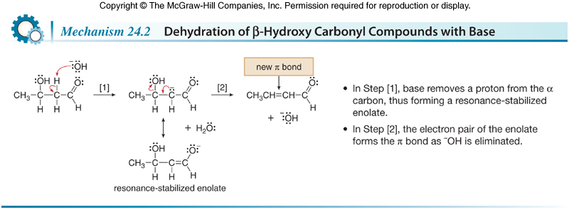
Carbonyl Condensation Reactions
The Aldol Reaction
The mechanism of dehydration consists of two steps: deprotonation followed by loss of ¯OH.

Slide 3
Carbonyl Condensation Reactions
The Aldol Reaction
An aldol reaction is often called an aldol condensation because the β-hydroxy carbonyl compound that is initially formed loses H₂O by dehydration. A condensation reaction is one in which a small molecule, in this case, H₂O, is eliminated during the reaction.
It may or may not be possible to isolate the β-hydroxy carbonyl compound under the conditions of the aldol reaction. When the α,β-unsaturated carbonyl compound is further conjugated with a carbon-carbon double bond or a benzene ring (as is the case in reaction 2), elimination of H₂O is spontaneous and the β-hydroxy carbonyl compound cannot be isolated.

